Slide 1

AUTO ALERTING AND IDENTIFICATION SYSTEM
Under the guidance of
Dr. Joshila Grace L. K., M.E., Ph.D.,
by
Shaik Sheeru Ali Moulali
Reg. No.: 39110932
Sathi Sarath Venkata Reddy
Reg. No.: 39110906

Slide 2
Presentation Outline
Introduction
Literature survey
Inferences from Literature Survey
Objectives
Domains Used
System Architecture
Proposed System
Snapshots
Result
Conclusion
References

Slide 3
Introduction
• Traffic collisions are frequently caused by driving drowsy.
• A significant problem in modern society is distracted driving.
It has an impact on sleepy drivers, but it also endangers all other road users.
Road accident prevention depends on the employment of helping technologies that track a vehicle's degree of alertness.
In the event of inattention or sleepiness, these systems should notify the driver.
Collisions will be less frequent only after the method is put into use, and certain cars' irritation will also go down.

Slide 4
Literature Review
S.No. | Paper Title | Author | Year | Disadvantage/Future Work
1 | Driver Drowsiness Detection System | Pratyush Agarwal, Rizul Sharma | 2019 | Improved incrementally by using other parameters like blink rate, yawning, state of the car, etc. If all these parameters are used it can improve the accuracy by a lot.
2 | Real-time Sleep Drowsiness Detection | Rizvi Khurram Abbas, Ansari Mohd Hasim | 2018 | Eye tracking works with eyeglasses and contact lenses since the calibration procedure accounts for the refractive properties of the lenses.
3 | Automatic Drunken Driver and Drowsiness Detection System | Mohammed Hussain, Shashank | 2020 | Damage of sensors cannot be detected.

Slide 5
Inferences from Literature Survey
The system fails if the automobile driver is wearing any kind of sunglasses and the system does not work if a light falls directly on the camera.
All these sensors are attached to the driver’s body which may affect the driver. all these disadvantages we designed a system in which a live camera is used to monitor the driver’s fatigue condition and alert the driver.
For large vehicles such as heavy trucks and buses this arrangement is not pertinent. The bus has a large front glass window to have a broad view for safe driving.
If we place a camera on the window of the front glass, the camera blocks the frontal view of the driver, then the camera is unable to detect the anterior view of the face of the driver correctly.

Slide 6
Objectives
The primary goal is to avoid hitting other automobiles.
A method that maintains the driver's attention on the road must be developed to address the issue of accidents caused by drivers who are fatigued.
Vehicles now use a variety of designs and prototypes. Keeping the whole focus and attention on precisely tracking the open and closed condition of the driver's eye in real-time would help prevent such incidents.
The system's goals are being assessed and developed to ensure reliability, low cost, low power consumption, quick response time, durability, and high security.

Slide 7
Domains Used
The Domains Used are:
Python
Computer Vision
Data Science
Machine Learning

Slide 8
Domains Used
Python
Python is a computer programming language.
It is a general-purpose, dynamic, and high-level language.
It is very easy to learn and yet very powerful when it comes to implementation.
Most of the Machine Learning, Deep Learning codes are written in Python.

Slide 9
Domains Used
Computer Vision
Computer Vision is a field of study that focuses on enabling machines to interpret and understand visual information from the world around them.
It involves the use of algorithms and deep learning techniques to extract meaningful information from images, videos, and other visual data.
Its applications are a wide range of fields, including autonomous vehicles, robotics, medical imaging, surveillance, and entertainment.
Some of the techniques used in Computer Vision include image classification, object detection, segmentation, and tracking.
Computer Vision systems rely on large amounts of labelled data to learn from, and their accuracy and effectiveness depend heavily on the quality and diversity of the data used for training.

Slide 10
Domains Used
Data Science
Data science is an interdisciplinary field that involves using scientific methods, algorithms, and systems to extract insights and knowledge from structured and unstructured data.
It involves a wide range of skills, including programming, statistics, machine learning, data visualization, and domain expertise.
Data scientists use various tools and technologies to collect, store, process, and analyze data.
Data science has applications in many industries, including healthcare, finance, marketing, and transportation, among others.

Slide 11
Domains Used
Machine Learning
ML stands for Machine Learning and It is a subset of Artificial Intelligence.
It involves the use of algorithms and statistical models to enable computer systems to improve their performance on a specific task over time.
ML can be supervised, unsupervised, or semi-supervised, depending on the availability of labelled data for training.
Applications of ML include speech recognition, image classification, natural language processing, fraud detection, and recommendation systems.
ML relies on large amounts of data to learn from, and its accuracy and effectiveness depend heavily on the quality and relevance of the data used for training.
ML is a rapidly growing field with a wide range of potential applications and opportunities for innovation and advancement.

Slide 12
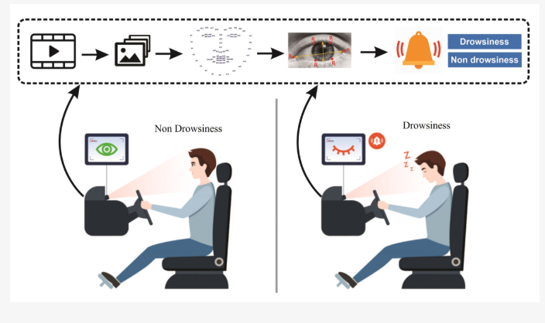
System Architecture
Fig.1 : Working function of the proposed system

Slide 13
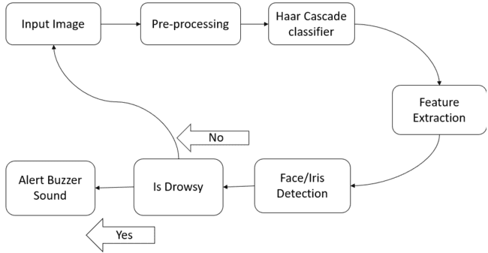
System Architecture
Fig.2: System Architecture of Proposed System

Slide 14
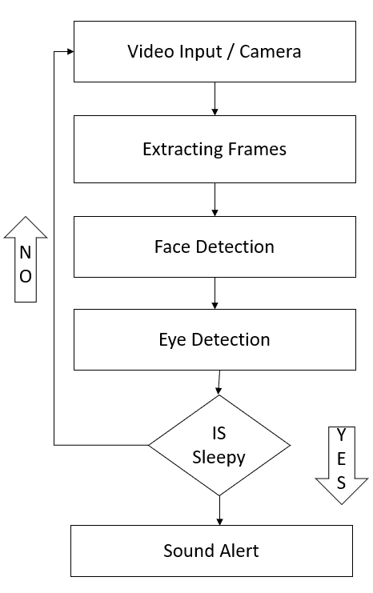
System Architecture
Fig.3: Flowchart of Proposed System

Slide 15
Proposed System
INPUT IMAGE: The input image for the system is a video stream captured from a camera mounted in the car facing the driver.
PRE-PROCESSING: The pre-processing step involves converting the color image to grayscale and then applying a series of filters to enhance the image quality and remove noise.
HAAR CASCADE CLASSIFIER ALGORITHM: The Haar Cascade Classifier is used for face detection. It works by searching for pixel intensities patterns that match a face's profile. Once the face is detected, the system extracts the region of interest (ROI) around the eyes.

Slide 16
Proposed System
FEATURE EXTRACTION: The system extracts features such as eye closure, blink duration, and eyelid movement to determine whether the driver is drowsy.
FACE DETECTION: The system uses face detection algorithms such as the Viola-Jones algorithm to detect the driver's face. Once the face is detected, the system extracts the region of interest (ROI) around the eyes.
IRIS DETECTION: The system uses iris detection algorithms to track the iris's movement and measure the pupil's diameter. This helps in determining if the driver is drowsy or not.
ALARM: An alarm is triggered if the system detects that the driver is drowsy. The alarm can be a sound, vibration, or visual warning.

Slide 17
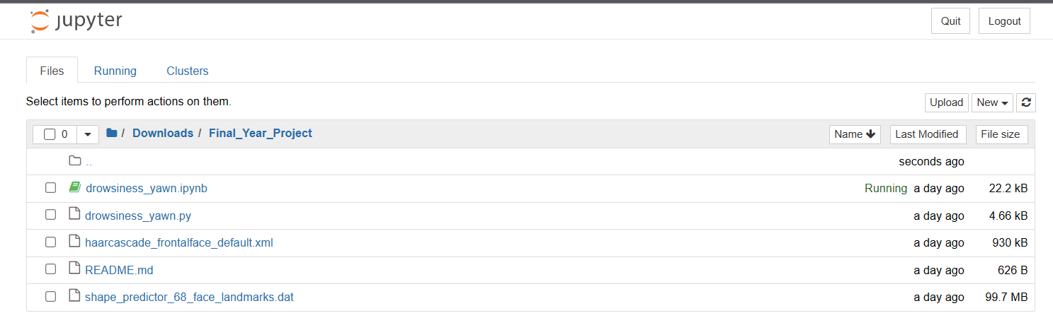
Snapshots
Fig 4: Required files

Slide 18
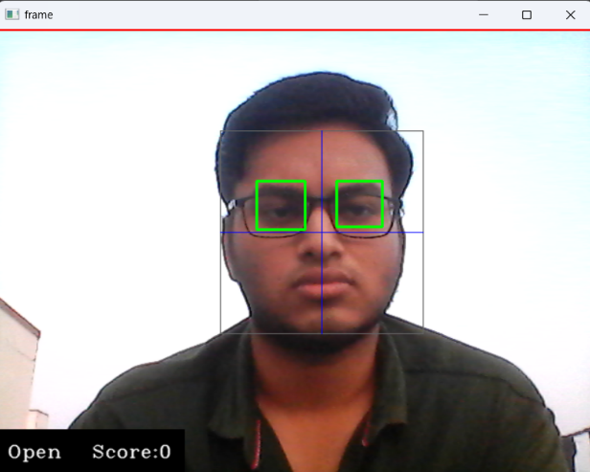
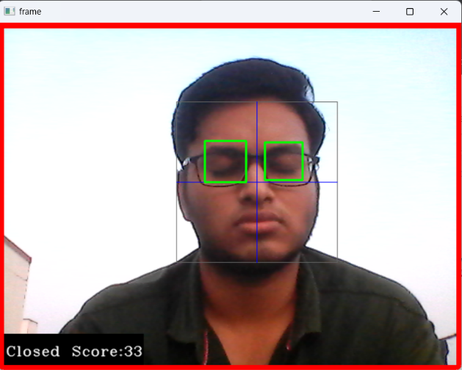
Snapshots
Fig.5: Day time detection with spectacles

Slide 19
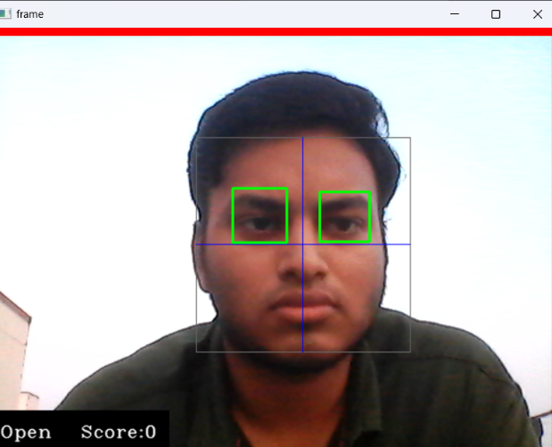
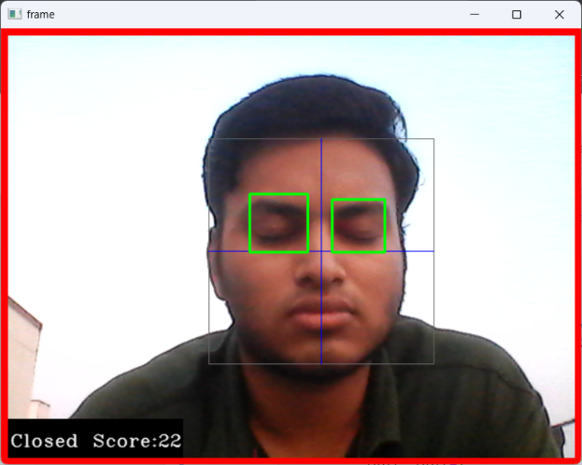
Snapshots
Fig.6: Day time detection without spectacles

Slide 20
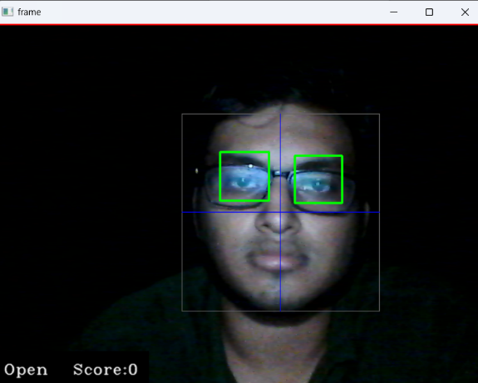
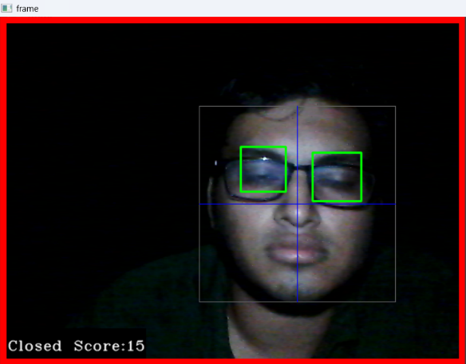
Snapshots
Fig.7: Night time detection with spectacles

Slide 21
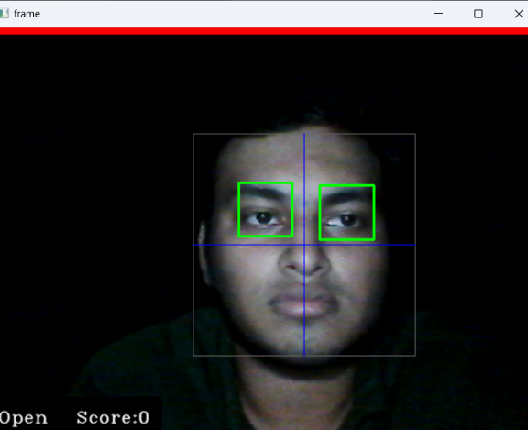
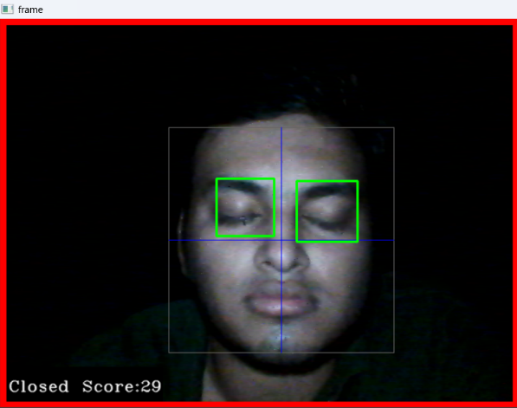
Snapshots
Fig.8: Night-time detection without spectacles

Slide 22
Result
The system uses components like cameras and buzzers to monitor the driver's behaviour.
It analyzes the driver's facial expressions, eye movements, and head position to determine their level of alertness.
The technology relies on sophisticated algorithms to detect patterns of drowsiness and fatigue.
The system alerts drivers using visual, audible, or haptic cues to prompt them to take a break or pull over.
The driver drowsiness detection system is becoming increasingly common in new vehicles and can be retrofitted to older ones.

Slide 23
Result
The technology is continuously evolving, with advancements being made to improve its accuracy and effectiveness.
Integration with other safety features, such as automatic emergency braking and lane departure warning systems, enhances overall road safety.
Despite its limitations, the system has the potential to significantly reduce accidents caused by driver fatigue, saving lives and preventing injuries on the road.
The driver drowsiness detection system is an example of how technology can be used to address safety concerns and reduce human error on the road.

Slide 24
Conclusion
The driver drowsiness detection system is an important technology that can help prevent accidents caused by tired drivers. It uses various components such as cameras and buzzers to monitor the driver's behaviour and alert them if they show signs of drowsiness. The system works by analyzing the driver's facial expressions, eye movements, and head position to determine their level of alertness. This technology is particularly important for long-distance truck drivers, who often spend long hours on the road and are at high risk of falling asleep at the wheel. The driver drowsiness detection system can help them stay alert and avoid accidents.

Slide 25
References
[1] According to G. Li and W.-Y. Chung's study, "Combined EEG-gyroscope DCS brain-machine interface system for the early treatment of driver fatigue," IEEE Trans. Human-Mach. Syst., vol. 48, no. 1, pp. 50-62, Feb. 2018.
[2] Akash Batra et al., Automated Automobile Speed Regulation with Wireless RF Control, 7(4): April 2018, pp.592-597, ISSN: 2277-9655.
[3] Automobile Speed Control Using Radio Frequency Communication, Volume 13, Issue 1, May 2016, ISSN 2349-9303. K. B. Shanghai and others.
[4] Automated Speed Regulation of Automobile in Limited Places Including RF as well as GSM, by A. Venkatesh and colleagues, Volume 02, No 09, December 2015, p. 875-877.

Slide 26
References
[5] Bhatti, A., Kamal, M. A., Ali, W., & Ahmed, S. (2020). A review on driver drowsiness detection using smartphone sensors. Computer Communications, 157, 26-39.
[6] "Detection of driver tiredness using a condition-adaptive representation learning framework," S. Park, J. Yu, M. Jeon, and S. Lee. Doi:
10.1109/TITS.2018.2883823, IEEE Trans. Intel. Transp. Syst., vol. 20, no. 11, pages 420–4218, November 2019.
[7] "Driver sleepiness identification based on respiratory signal analysis," F. Guede-Fernández, M. Fernández-Chimeno, J. Ramos-Castro, and M. A. Garca-González. doi:10.1109/ACCESS.2019.2924481, IEEE Access, vol. 7, p. 81826–81388, 2019.

Slide 27
References
[8] Driver Drowsiness Recognition Using 3D Conditional GAN with Two-Level Attention Bi-LSTM was a paper by Y. Hu, M. Lu, C. Xie, and X. Lu published in IEEE Trans. Circuits Syst. Video Technol., vol. 30, no. 12, Dec. 2020, pp. 4755-4768.
[9] Liu, X., Guo, Z., & Zhang, L. (2020). A review of driver drowsiness detection methods based on vision techniques. IEEE Access, 8, 136366-136380.
[10] R. Ashok Kumar, "A Beacon Based Automated Vehicle Speed Control System for Limited Zone," Volume 7, No. X, October 2018, pp. 1152-1159.

Slide 28
References
[11] R. Deepa's article "Design of Vehicle Speed Control System Utilizing Wireless Instrument Cluster," Volume 4, Issue 1, January 2015.
[12] Sharma, A., & Gupta, R. (2021). A review on driver drowsiness detection techniques. SN Computer Science, 2(4).
[13] Y. Saito, M. Itoh, and T. Inagaki conducted the study under the title "Driver assistance system with a dual control scheme: Effectiveness of detecting driver fatigue and reducing lane departure accidents." IEEE Trans. Human-Mach. Syst., vol. 46, no. 5, Oct. 2016, pp. 660–671. 10.1109/THMS.2016.2549032 is the ISBN.

Slide 29
THANK YOU
I thank my guide, panel members, all technical and non-technical staff for helping me achieve this.

